Slide 1


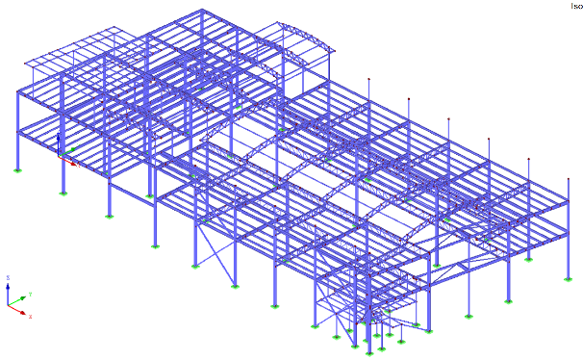




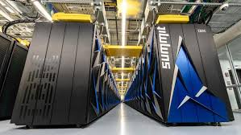







Steel
Lic. Jaime M. Roza Pedreira
Gerente de Soporte Tecnico
Steel
Ing. Antonio Marco Garnell
C.I.V: 80534
Gerente General
Structural
Structural
Design Co.
Design Co.
+58 241 826.97.16
+58 241 826.97.16
+58 414 407.91.99
+58 414 640.62.39
Steel
Structural
Calculo Estructural
Acero y Concreto
jrozap@gmail.com
antoniomarco2021@msn.com
Design Co.
structuralsteel.design.co@gmail.com
structuralsteel.design.co@gmail.com
El Parral, Av. Rio Orinoco, Multicentro Paseo el Parral, Piso 8, Ofc. 8-5, Valencia
Calculo Estructural
Acero y Concreto
El Parral, Av. Rio Orinoco, Multicentro Paseo el Parral, Piso 8, Ofc. 8-5, Valencia
Calculo Estructural
Acero y Concreto
Diseño de Estructuras en Acero y Concreto
Diseño de Estructuras en Acero y Concreto
JR Sistemas 24
Steel
Ing. Jose Vicente Salcedo Marco
C.I.V: 19400
Gerente de Proyectos
+58 241 826.97.16
Structural
Design Co.
+58 414 407.91.99
Lic. Jaime M. Roza Pedreira
Gerente General
structuralsteel.design.co@gmail.com
El Parral, Av. Rio Orinoco, Multicentro Paseo el Parral, Piso 8, Ofc. 8-5, Valencia
Diseño de Estructuras en Acero y Concreto
Sistemas de Informacion
DBMS Analysis
+58 241 826.97.16
+58 241 826.97.16
+58 414 407.91.99
+57 301 242.13.24
jrozap@gmail.com
ledservice00@msn.com
jrsistemas24@gmail.com
structuralsteel.design.co@gmail.com
El Parral, Av. Rio Orinoco, Multicentro Paseo el Parral, Piso 8, Ofc. 8-5, Valencia
El Parral, Av. Rio Orinoco, Multicentro Paseo el Parral, Piso 8, Ofc. 8-5, Valencia
Calculo Estructural
Acero y Concreto
Diseño de Estructuras en Acero y Concreto
Steel
structuralsteel.design.co@gmail.com
Structural
Steel
Design Co.
PROYECTO: Estructura Polideportivo
Design Co.
Structural
CALCULO: Ing. Antonio Marco G.
C.I.V: 80534
Calculo Estructural
Acero y Concreto
COPYRIGHT © 2019

Slide 2
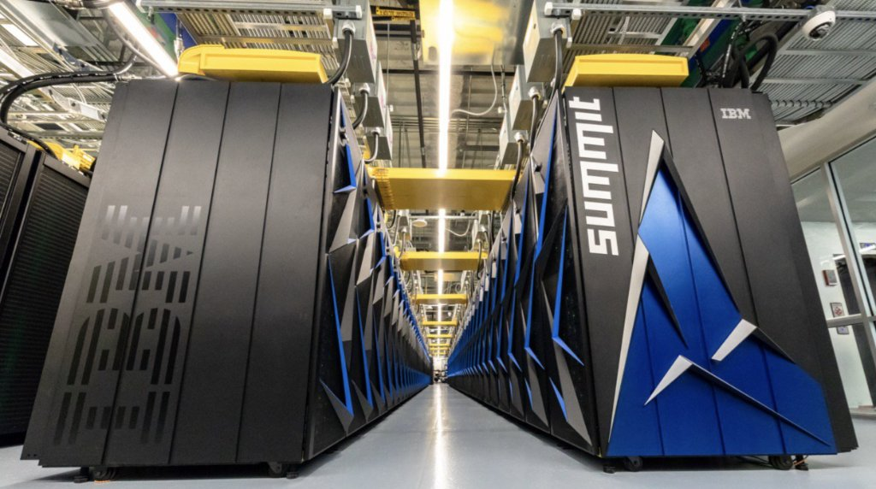



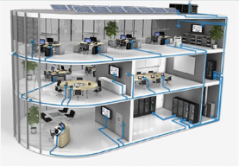



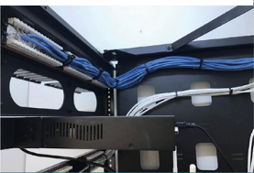

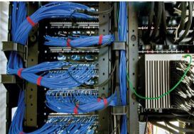
JR Sistemas 24
JR Sistemas 24
SQL SCRIPTS Dev

Slide 3




































Slide 4









Slide 5
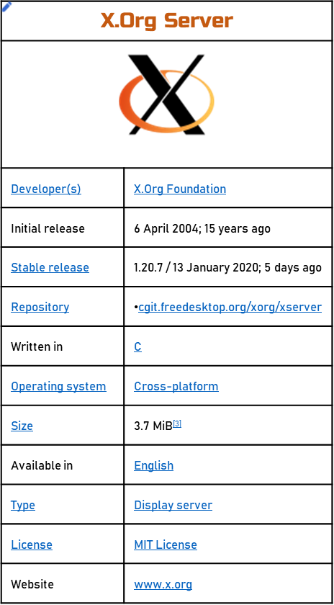
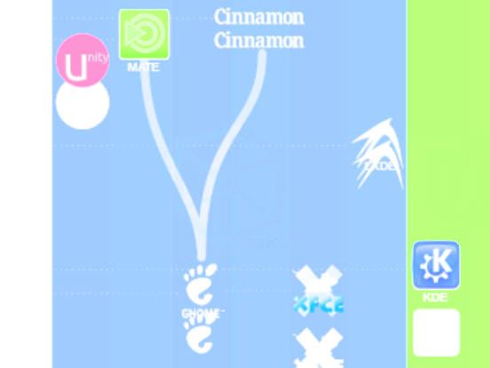
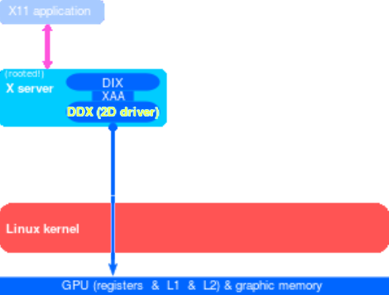
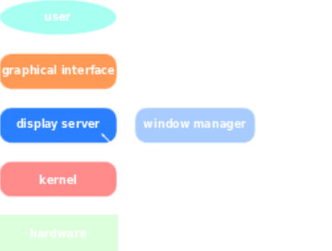
2012
2011
2010
2009
2008
2007
2006
2005
2004
2003
2002
2001
2000
1999
1998
1997
1996

Slide 6
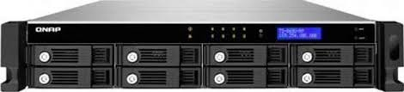
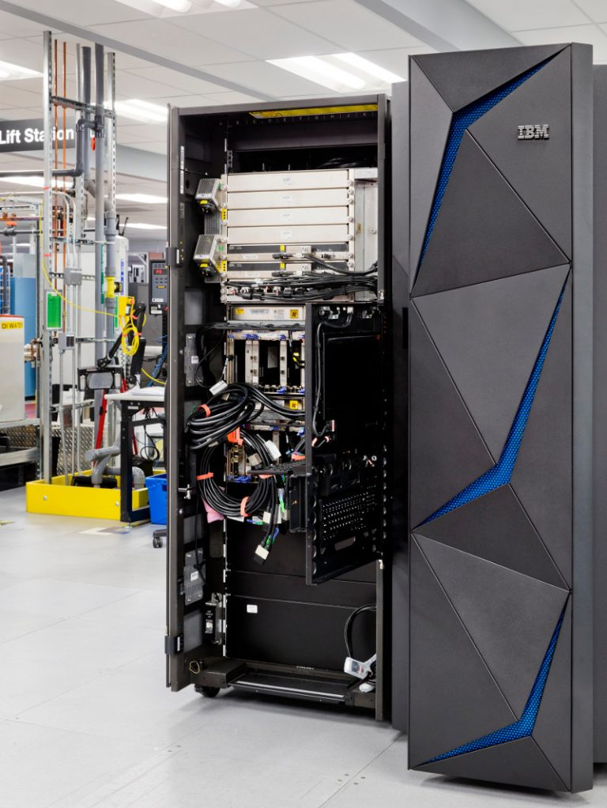
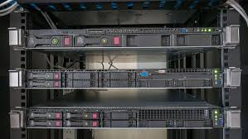

Slide 7
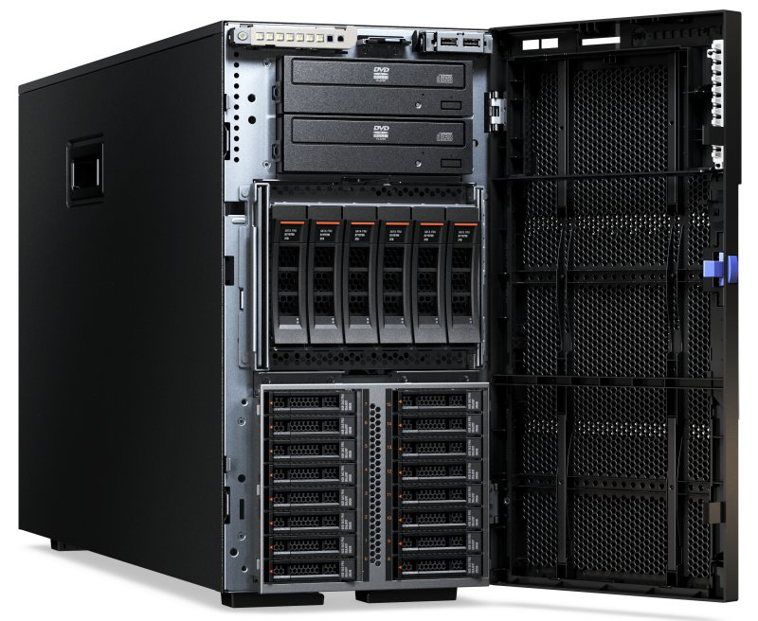

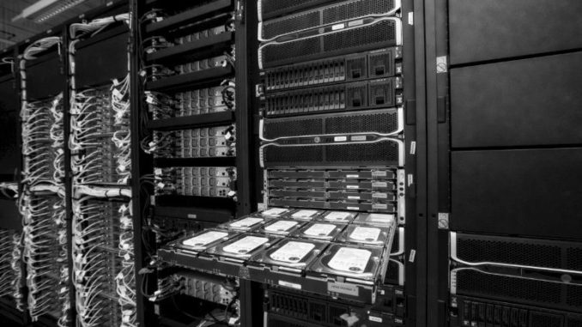


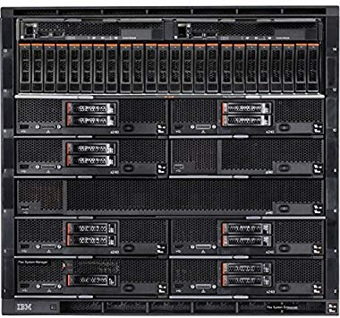

Slide 8
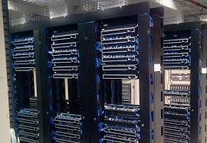
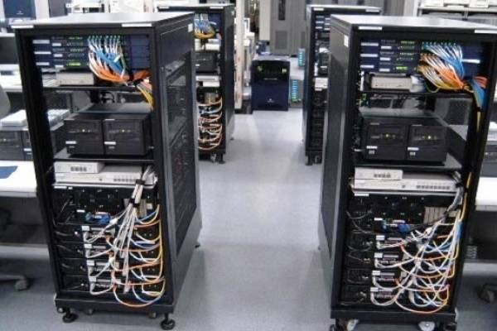
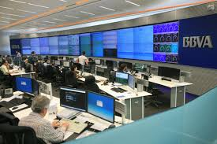
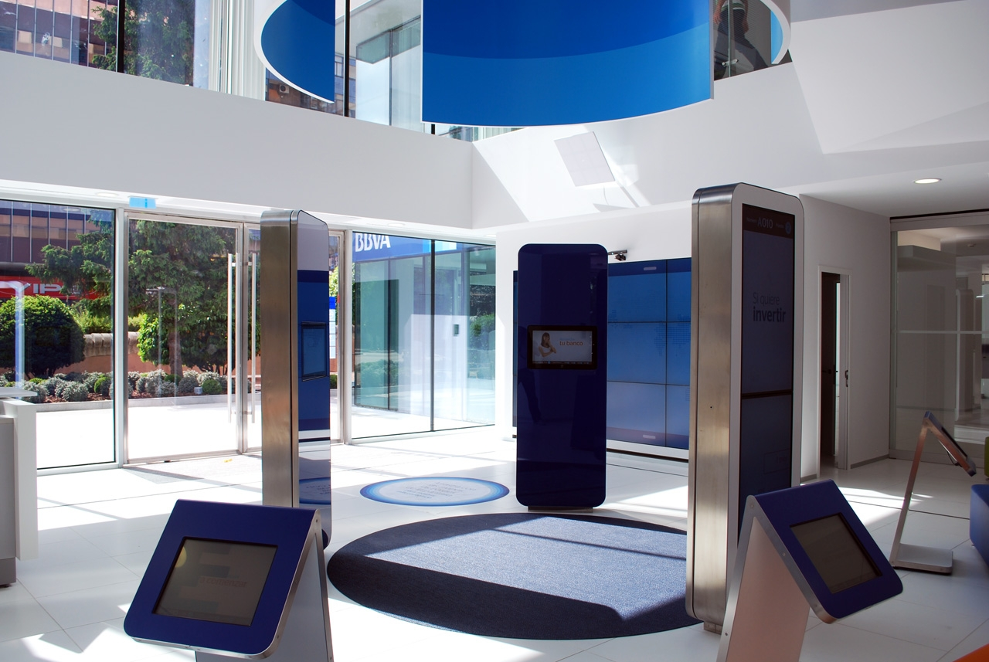
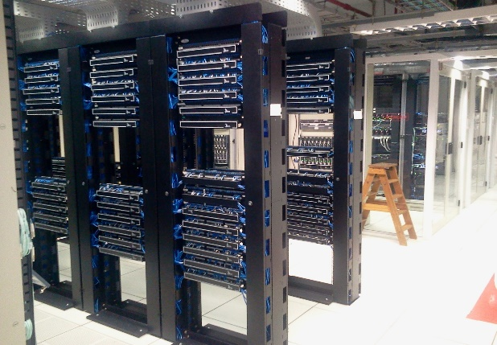
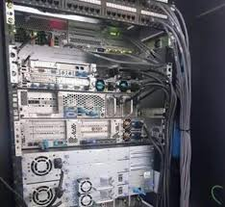
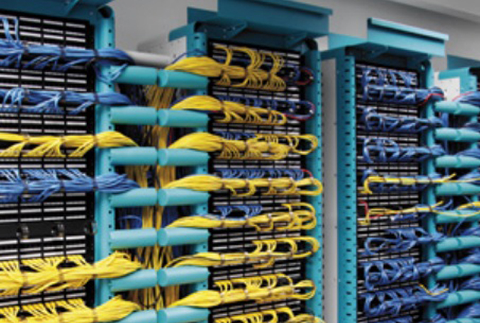
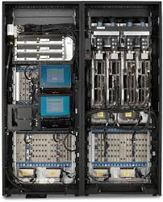
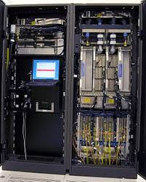
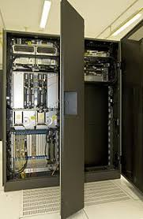
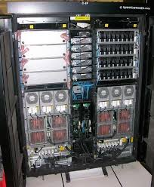
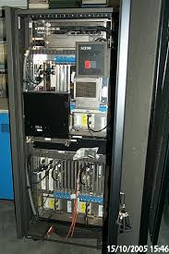
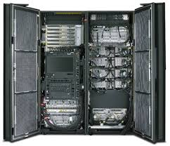

Slide 9
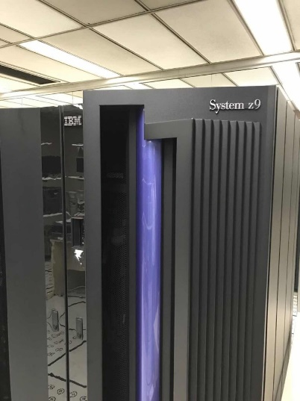
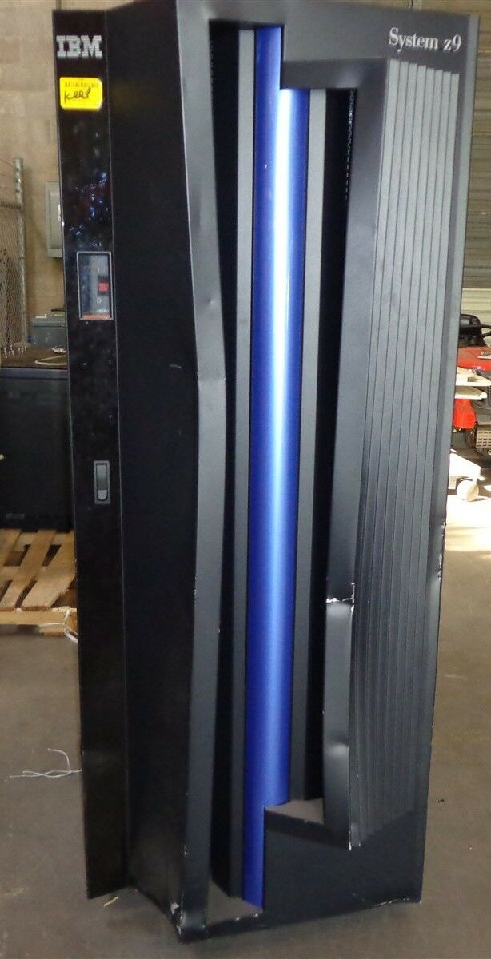
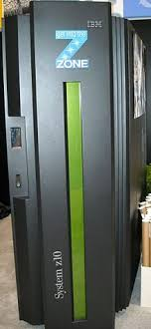
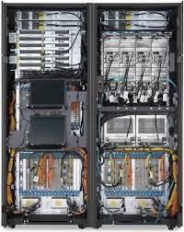

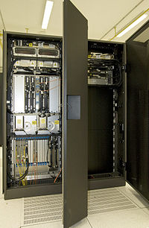
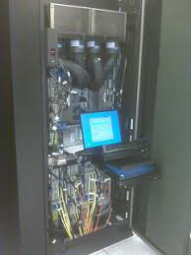
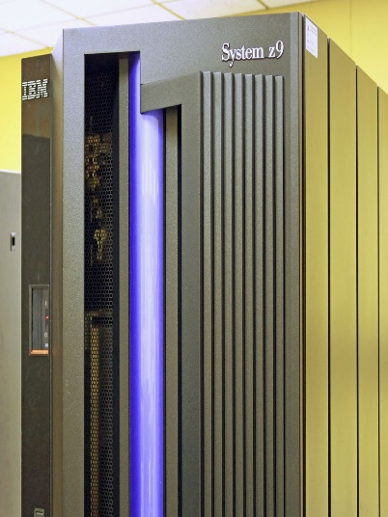
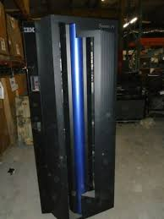
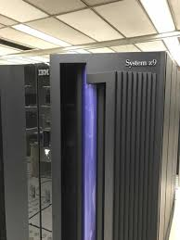
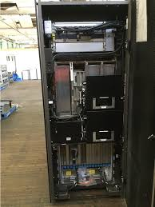
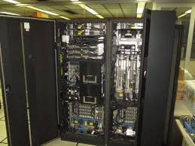

Slide 10
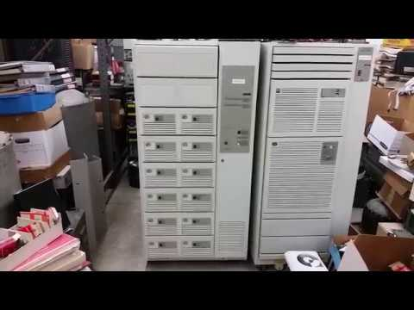
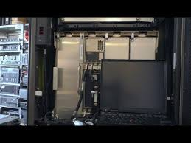
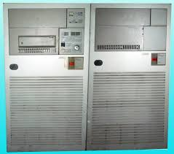
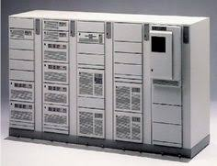
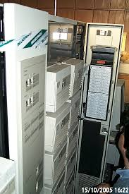
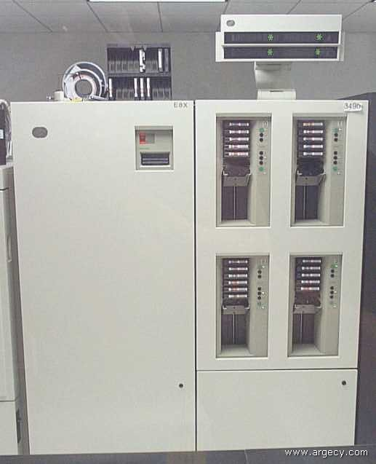
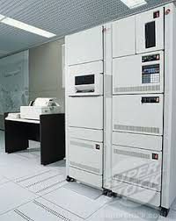
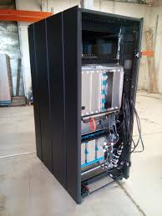
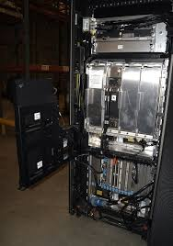

Slide 11
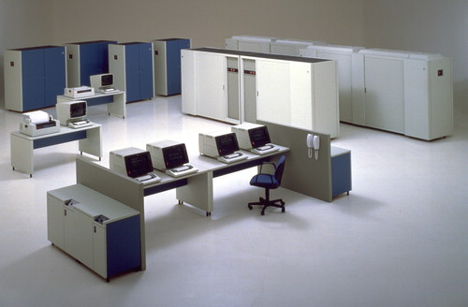












Slide 12




Sistemas
Operativos

Slide 13




Slide 14




















App
Pago Seguro SMS
Pago SMS Mercantil
Cliente:
Jaime M. Roza Pedreira
Orden Pago:
DDT-15122018-00000001
Datos del Cliente
Datos del Pago
SMS a Enviar a Tpago
Cedula Identidad:
RIF Dynamics:
Datos del Móvil
V-6122625
J4019871260
# Móvil:
Enviar
04144079199 75202
0414-4079199
Móvil Asociado:
Cuenta a Debitar:
0414 4078021
Cancelar
SMS Mercantil
CC1 Cta. Corriente 1
Cuenta Dynamics:
TPAGO V6122625 CC1 0105 04144078021 J4019871260
1500000 78684081
Clave Temporal Mercantil:
Mercantil Banco Universal
Ver OP…
78684081
Solicitar esta a Mercantil vía SMS al: 24024
Tipo de Cuenta a Debitar:
CC1 Cta. Corriente 1
CC2 Cta. Corriente 2
CA1 Cta. Ahorros 1
CA2 Cta. Ahorros 2
0105 Mercantil Banco Universal
0134 Banesco
0108 BBVA Provincial
0114 Bancaribe
0102 Banco de Venezuela

Slide 15
App
Pago Seguro SMS
Pago SMS Banesco
Cliente:
Jaime M. Roza Pedreira
Orden Pago:
DDT-15122018-00000001
Datos del Cliente
Datos del Pago
SMS a Enviar a Banesco
Cedula Identidad:
RIF Dynamics:
Datos del Móvil
V-6122625
J4019871260
Enviar
04144079199 75202
# Móvil:
Móvil Asociado:
0414-4079199
0414 4078021
Cancelar
SMS Banesco
Cuenta Dynamics:
0105 04144078021 J 4019871260 1500000,00
Mercantil Banco Universal
Ver OP…
0105 Mercantil Banco Universal
0134 Banesco
0108 BBVA Provincial
0114 Bancaribe
0102 Banco de Venezuela

Slide 16
App
Pago Seguro SMS
Pago SMS Bancaribe
Cliente:
Jaime M. Roza Pedreira
Orden Pago:
DDT-15122018-00000001
Datos del Cliente
Datos del Pago
SMS a Enviar a Bancaribe
Cedula Identidad:
RIF Dynamics:
Datos del Móvil
V-6122625
J4019871260
Enviar
04144079199 75202
# Móvil:
Móvil Asociado:
0414-4079199
0414 4078021
Cancelar
SMS Banesco
Cuenta Dynamics:
mipago J4019871260 0105 1500000,00 04144078021
Mercantil Banco Universal
Ver OP…
0105 Mercantil Banco Universal
0134 Banesco
0108 BBVA Provincial
0114 Bancaribe
0102 Banco de Venezuela

Slide 17
App
Pago Seguro SMS
Pago SMS Banco de Venezuela
Cliente:
Jaime M. Roza Pedreira
Orden Pago:
DDT-15122018-00000001
Datos del Cliente
Datos del Pago
SMS a Enviar a BDV
Cedula Identidad:
RIF Dynamics:
Datos del Móvil
V-6122625
J4019871260
Enviar
04144079199 75202
# Móvil:
Móvil Asociado:
0414-4079199
0414 4078021
Cancelar
SMS BDV
Cuenta Dynamics:
PAGAR 0105 04144078021 J4019871260 1500000,00
Mercantil Banco Universal
Ver OP…
0105 Mercantil Banco Universal
0134 Banesco
0108 BBVA Provincial
0114 Bancaribe
0102 Banco de Venezuela

Slide 18
App
Pago Seguro SMS
Pago SMS Banco Fondo Común
Cliente:
Jaime M. Roza Pedreira
Orden Pago:
DDT-15122018-00000001
Datos del Cliente
Datos del Pago
SMS a Enviar a BFC
Cedula Identidad:
RIF Dynamics:
Datos del Móvil
V-6122625
J4019871260
Enviar
04144079199 75202
# Móvil:
Móvil Asociado:
0414-4079199
0414 4078021
Cancelar
SMS BFC
Cuenta Dynamics:
PAT 0105 04144078021 1500000,00 J4019871260
Mercantil Banco Universal
Ver OP…
0105 Mercantil Banco Universal
0134 Banesco
0108 BBVA Provincial
0114 Bancaribe
0102 Banco de Venezuela

Slide 19
App
Pago Seguro SMS
Pago SMS Banco del Tesoro
Cliente:
Jaime M. Roza Pedreira
Orden Pago:
DDT-15122018-00000001
Datos del Cliente
Datos del Pago
SMS a Enviar a Banco del Tesoro
Cedula Identidad:
RIF Dynamics:
Datos del Móvil
V-6122625
J4019871260
Enviar
04144079199 75202
# Móvil:
Móvil Asociado:
0414-4079199
0414 4078021
Cancelar
SMS BDT
Clave Tarjeta Coordenadas:
Cuenta Dynamics:
PAGAR 0105 04144078021 J 4019871260 1500000,00 832
832
Mercantil Banco Universal
Ver OP…
Debe escoger una de su tarjeta de coordenadas
0105 Mercantil Banco Universal
0134 Banesco
0108 BBVA Provincial
0114 Bancaribe
0102 Banco de Venezuela

Slide 20
App
Pago Seguro SMS
Pago SMS Banco Exterior
Cliente:
Jaime M. Roza Pedreira
Orden Pago:
DDT-15122018-00000001
Datos del Cliente
Datos del Pago
SMS a Enviar a BExterior
Cedula Identidad:
RIF Dynamics:
Datos del Móvil
V-6122625
J4019871260
Enviar
04144079199 75202
# Móvil:
Móvil Asociado:
0414-4079199
0414 4078021
Cancelar
SMS BFC
Cuenta Dynamics:
PAGAR 0105 04144078021 J 4019871260 1500000,00
Mercantil Banco Universal
Ver OP…
0105 Mercantil Banco Universal
0134 Banesco
0108 BBVA Provincial
0114 Bancaribe
0102 Banco de Venezuela

Slide 21
App
Pago Seguro SMS
Pago SMS BOD
Cliente:
Jaime M. Roza Pedreira
Orden Pago:
DDT-15122018-00000001
Datos del Cliente
Datos del Pago
SMS a Enviar a BOD
Cedula Identidad:
RIF Dynamics:
Datos del Móvil
V-6122625
J4019871260
Enviar
04144079199 75202
# Móvil:
Móvil Asociado:
0414-4079199
0414 4078021
Cancelar
SMS BOD
Cuenta Dynamics:
PAGO 6122625 0105 04144078021 J4019871260 1.500.000
Mercantil Banco Universal
Ver OP…
0105 Mercantil Banco Universal
0134 Banesco
0108 BBVA Provincial
0114 Bancaribe
0102 Banco de Venezuela

Slide 22
App
Pago Seguro SMS
Pago SMS BVC
Cliente:
Jaime M. Roza Pedreira
Orden Pago:
DDT-15122018-00000001
Datos del Cliente
Datos del Pago
SMS a Enviar a BVC
Cedula Identidad:
RIF Dynamics:
Datos del Móvil
V-6122625
J4019871260
Enviar
04144079199 75202
# Móvil:
Móvil Asociado:
0414-4079199
0414 4078021
Cancelar
SMS BVC
Tipo de Cuenta:
Cuenta Dynamics:
PP 6122625 CTE 0105 J4019871260 04144078021 1.500.000
CTE –Cta. Corriente BVC
Mercantil Banco Universal
Ver OP…
CTE Cta. Corriente BVC
AHO Cta. Ahorro BVC
ASD Cta. Ahorro Saldo Diario BVC
0105 Mercantil Banco Universal
0134 Banesco
0108 BBVA Provincial
0114 Bancaribe
0102 Banco de Venezuela

Slide 23
App
Pago Seguro SMS
Pago SMS Banco BBVA Provincial
Cliente:
Jaime M. Roza Pedreira
Orden Pago:
DDT-15122018-00000001
Datos del Cliente
Datos del Pago
SMS a Enviar a BBVA Provincial
Cedula Identidad:
RIF Dynamics:
Datos del Móvil
V-6122625
J4019871260
Enviar
04144079199 75202
# Móvil:
Móvil Asociado:
0414-4079199
0414 4078021
Cancelar
SMS BBVA Provincial
Cuenta a Debitar:
Cuenta Dynamics:
PP 6122625 CC1 0105 04144078021 J 4019871260 1500000,00
CC1 Cta. Corriente 1
Mercantil Banco Universal
Ver OP…
0105 Mercantil Banco Universal
0134 Banesco
0108 BBVA Provincial
0114 Bancaribe
0102 Banco de Venezuela
Tipo de Cuenta a Debitar:
CC1 Cta. Corriente 1
CC2 Cta. Corriente 2
CA1 Cta. Ahorros 1
CA2 Cta. Ahorros 2

Slide 24


App
Pago Seguro Bank of America
Online Banking API
Options Menu
Add a New Recipient
Protect your Identity
Add a Receipt Phone / Mail
Individual
Business
Modify a Receipt Phone / Mail
Business Name: *
Help / Tips
To help protect your identity from fraud enter the Bank of America debit or credit card information associated with your account. Request an optional debit or credit card
Dynamics International, Inc.
Business Name: Name of Company / Merchant in the account principal name. * Mandatory Field.
Nickname: Name in your managed payments. Is an optional field.
E-Mail or Phone Number: e-Mail or phone registered in the Bank’s Records. * Mandatory Field.
ABA/SWIFT Code: International ISO Code for recipient account. * Mandatory Field.
Send Money
Nickname (optional):
View Activity
Dynamics
E-Mail Address or Mobile Number: *
Authenticate
dynamics.dental@gmail.com
Confirm e-Mail Address or Mobile Number: *
Card number:
5300769200014098
dynamics.dental@gmail.com
Expiration:
08
2021
ABA/SWIFT Code (Recipient): *
3 or 4 digit
security:
BOFAUS3N – Bank of America (BofA – USA)
832
Verify
* Required Field
What This?

Slide 25
App
Pago Seguro Bank of America
Online Banking API
Options Menu
Add a New Recipient
Protect your Identity
Add a Receipt Phone / Mail
Individual
Business
Modify a Receipt Phone / Mail
Help / Tips
To help protect your identity from fraud enter the Bank of America debit or credit card information associated with your account. Request an optional debit or credit card
Bank Routing Number:
BOFAUS3N
Send Money
Bank Name:
Bank of America
Bank Routing Number: International Bank Code.
Bank Name: Name of recipient bank.
Address: Financial Agency Address.
ZIP Code: US State Postal Code.
City: City that resides the Bank.
State: State that resides the Bank.
Country: Country of recipient Bank.
View Activity
Address: *
2308 Ponce de León Blvd, Coral Gables
ZIP Code: *
City: *
Authenticate
33134
Miami
State / Province: *
Country: *
Card number:
5300769200014098
Florida
USA
Expiration:
08
2021
Next
3 or 4 digit
security:
832
Verify
* Required Field
What This?

Slide 26
App
Pago Seguro Bank of America
Online Banking API
Options Menu
Modify Recipient
Protect your Identity
Add a Receipt Phone / Mail
Individual
Business
Modify a Receipt Phone / Mail
Business Name:
Dynamics International, Inc.
Help / Tips
To help protect your identity from fraud enter the Bank of America debit or credit card information associated with your account. Request an optional debit or credit card
Nickname:
Dynamics BofA
Send Money
E-Mail Address
or Mobile Number:
dynamics.dental@gmail.com
Business Name: Name of Company / Merchant in the account principal name.
Nickname: Name in your managed payments. Is an optional field.
E-Mail or Phone Number: e-Mail or phone registered in the Bank’s Records.
View Activity
Bank Routing
Number:
BOFAUS3N
Bank Name:
Bank of America
Authenticate
Address:
2308 Ponce de León Blvd, Coral Gables
ZIP Code:
33134
City:
Miami
Card number:
5300769200014098
State / Province:
Florida
Expiration:
08
2021
Country:
USA
3 or 4 digit
security:
832
Verify
* Required Field
Done
What This?

Slide 27


App
Pago Seguro Bank of America
Online Banking API
Options Menu
Send Money
Help / Tips
Add a Receipt Phone / Mail
Securely send money to other people using their email address or mobile number
Modify a Receipt Phone / Mail
From: *
MyAccess Checking – xxxxxx – AvailBal $ 1,545.06
Send Money
Dynamics BofA
Add a email or mobile recipient
View Activity
To: *
Amount: *
259
Money sent to pay the invoice DDT-15122018-00000001 to Dynamics Inc.
Message:
(Optional)
For your security do not include any personal or account information in this message
* Required Field
Continue Transfer

Slide 28

App
Pago Seguro Bank of America
Online Banking API
Options Menu
Send Money
Confirm
Add a Receipt Phone / Mail
Because this recipient is currently enrolled in the email/mobile transfer network as a Bank of America customer, funds will be delivered immediately to the recipient’s account.
Modify a Receipt Phone / Mail
Send Money
From:
MyAccess Checking – 2259
View Activity
To:
Dynamics BofA
Amount:
259
Message:
(Optional)
Money sent to pay the invoice DDT-15122018-00000001 to Dynamics Inc.
Please make sure there are sufficient funds, or you may changed an overdraft fee. Please refer to tour account agreement and applicable fee schedule for details.
Make Transfer
Don’t make Transfer

Slide 29
App
Pago Seguro Bank of America
Online Banking API
Options Menu
Send Money
Showing: All transfers in the last 30 days.
Add a Receipt Phone / Mail
Change filter options
Modify a Receipt Phone / Mail
Send Money
Transfer Activity
View Activity
Date Status Description From / Requested From To Amount
12/15/2019 Completed Outgoing Transfer MyAccess Checking – 2259 Dynamics BofA $259.00
11/15/2019 Completed Outgoing Transfer MyAccess Checking – 2259 Dynamics BofA $184.00
11/15/2019 Canceled Outgoing Transfer MyAccess Checking – 2259 Dynamics BofA $134.00

Slide 30


App
Secure Payment CHASE Manhattan
Online Banking API
Options Menu
Add Wire Recipient
Add a Wire Receipt
Individual
Business
Modify a Wire Receipt
Business Data
Bank & Account Data
Send Money
Business Name: *
Dynamics International, Inc.
ABA/SWIFT Code: *
BOFAUS3N – Bank of America (USA)
View Activity
Nickname: *
Dynamics-Chase
Bank Routing Number:
BOFAUS3N
Bank Name:
Bank of America
Address # 1: *
2515 Ponce de León Blvd, Coral Gables
Address: *
2308 Ponce de León Blvd, Coral Gables
Address # 2: *
ZIP Code: *
33134
City: *
Miami
City: *
Miami
State: *
Florida
State: *
Florida
Country: *
USA
E-Mail Address or Mobile Number: *
Province (Outside US): *
dynamics.dental@gmail.com
Confirm e-Mail Address or Mobile Number: *
Country: *
United States of America (USA)
dynamics.dental@gmail.com
Next
* Required Field

Slide 31
App
Secure Payment CHASE Manhattan
Online Banking API
Options Menu
Add Wire Recipient
Add a Wire Receipt
Individual
Business
Modify a Wire Receipt
Business Data
Bank & Account Data
Send Money
Business Name:
Dynamics International, Inc.
Bank Routing Number:
BOFAUS3N
View Activity
Nickname:
Dynamics-Chase
Bank Name:
Bank of America
Address # 1:
2515 Ponce de León Blvd, Coral Gables
Address:
2308 Ponce de León Blvd, Coral Gables
ZIP Code:
33134
City:
Miami
City:
Miami
State:
Florida
State:
Florida
Country:
USA
Country:
United States of America (USA)
E-Mail Address or Mobile Number:
dynamics.dental@gmail.com
Done

Slide 32
App
Secure Payment CHASE Manhattan
Online Banking API
Options Menu
Modify Wire Recipient
Add a Wire Receipt
Individual
Business
Modify a Wire Receipt
Business Data
Bank & Account Data
Send Money
Business Name:
Dynamics International, Inc.
ABA/SWIFT Code: *
BOFAUS3N – Bank of America (USA)
View Activity
Nickname:
Dynamics-Chase
Bank Routing Number:
BOFAUS3N
Bank Name:
Bank of America
Address # 1: *
2515 Ponce de León Blvd, Coral Gables
Address: *
2308 Ponce de León Blvd, Coral Gables
Address # 2: *
ZIP Code: *
33134
City: *
Miami
City: *
Miami
State: *
Florida
State: *
Florida
Country: *
USA
E-Mail Address or Mobile Number: *
Province (Outside US): *
dynamics.dental@gmail.com
Confirm e-Mail Address or Mobile Number: *
Country: *
United States of America (USA)
dynamics.dental@gmail.com
Next
* Required Field

Slide 33
App
Secure Payment CHASE Manhattan
Online Banking API
Options Menu
Add Wire Recipient
Add a Wire Receipt
Individual
Business
Modify a Wire Receipt
Business Data
Bank & Account Data
Send Money
Business Name:
Dynamics International, Inc.
Bank Routing Number:
BOFAUS3N
View Activity
Nickname:
Dynamics-Chase
Bank Name:
Bank of America
Address # 1:
2515 Ponce de León Blvd, Coral Gables
Address:
2308 Ponce de León Blvd, Coral Gables
ZIP Code:
33134
City:
Miami
City:
Miami
State:
Florida
State:
Florida
Country:
USA
Country:
United States of America (USA)
E-Mail Address or Mobile Number:
dynamics.dental@gmail.com
Done

Slide 34

App
Secure Payment CHASE Manhattan
Online Banking API
Options Menu
Send Money to…
Add a Wire Receipt
Wire From: *
MyAccess Checking – xxxxxx – AvailBal $ 1,545.06
Modify a Wire Receipt
Send Money
Select a Recipient
Bank & Account Data
View Activity
X
Dynamics-Chase
Dynamics International, Inc.
BOFAUS3N
Wire From:
MyAccess Checking – xxxxxx
American-Elect
American Electric Power, Inc.
ABBYGB2LINS
Wire To:
Dynamics-Chase-BOFAUS3N
Young-MDSupp
Young’s Medical Suppliers, Inc.
BOFAUS3N
Wire Amount: *
1500,00
U.S. Dollars (US$)
Monica’s-BofA
Monica’s Wholesales, Inc.
BOFAUS3N
Wire Date: *
12/19/2019
Godham-BofA
GodHam, Inc.
BOFAUS3N
Message to Recipient:
Money sent to pay the invoice DDT-15122018-00000001 to Dynamics Inc.
Max. 140 Char
Lenovo-Abbey Bnk
Dynamics International, Inc.
ABBYGB2LINS
Business Name:
Dynamics International, Inc.
BOFAUS3N
Instructions for
Recipient’s Bank:
Max. 100 Char
Bank Routing Number:
Dynamics-Chase
Bank of America
Nickname:
Bank Name:
Memo:
Invoice DDT-15122018-00000001
Max. 100 Char
E-Mail Address or Mobile:
dynamics.dental@gmail.com
* Required Field
Next
Cancel

Slide 35
App
Secure Payment CHASE Manhattan
Online Banking API
Options Menu
Send Money to…
Add a Wire Receipt
Transaction Review
Modify a Wire Receipt
Wire From:
MyAccess Checking – xxxxxx
Send Money
Wire To:
Dynamics-Chase-BOFAUS3N
View Activity
Bank Routing Number:
BOFAUS3N
Business Name:
Dynamics International, Inc.
Nickname:
Dynamics-Chase
Bank Name:
Bank of America
E-Mail Address or Mobile:
dynamics.dental@gmail.com
Wire Amount:
1500,00
U.S. Dollars (US$)
Message to Recipient:
Money sent to pay the invoice DDT-15122018-00000001 to Dynamics Inc.
Wire Date:
12/19/2019
Memo:
Invoice DDT-15122018-00000001
Instructions for
Recipient’s Bank:
Done

Slide 36
App
Secure Payment CHASE Manhattan
Online Banking API
Options Menu
View Wired Activity
Add a Wire Receipt
Details
Wire to
Wire From
Debit Amount
Send Amount
Wire Date
Status
Transaction #
Actions
Modify a Wire Receipt
Dynamics-Chase-BOFAUS3N
MyAccess Checking – xxxxxx
$ 1500,00
$ 1500,00
12/19/2019
Pending…
246810121
See
Change
Cancel
Send Money
American-Elect-
MyAccess Checking – xxxxxx
$ 700,00
$ 700,00
Completed
See
Inquiry
View Activity
ABBYGB2LINS
12/15/2019
23456721
Young-MDSupp-
MyAccess Checking – xxxxxx
$ 2500,00
$ 2500,00
12/10/2019
Pending…
234810671
See
Change
Cancel
BOFAUS3N
Monica’s-BofA-
MyAccess Checking – xxxxxx
$ 344,00
$ 334,00
12/07/2019
Completed
234511121
See
Inquiry
BOFAUS3N
Godham-BofA-
MyAccess Checking – xxxxxx
$ 695,00
$ 695,00
12/07/2019
Completed
234410431
See
Inquiry
BOFAUS3N
Lenovo-Abbey Bnk-<
MyAccess Checking – xxxxxx
$ 15000,00
$ 15000,00
12/05/2019
Completed
2341101112
See
Inquiry
ABBYGB2LINS
Done

Slide 37


Slide 38


Slide 39


Slide 40


Slide 41


Slide 42




W
S
W
S
Web Services

Slide 43



Slide 44






RHEL version | Release date |  | End of Full Support |  | End Maint Support 1 (RHEL 5, 6, 7) | End Main Support 1 (RHEL 8), Maint Support 2 (RHEL 5, 6, 7) |  | End Extended Lifecycle Support | minor release
2.1 | 26 March 2002 (AS) 1 May 2003 (ES) |  | 30 November 2004 |  | 31 May 2005 | 31 May 2009 |  | N/A | —
3 | 23 October 2003 |  | 20 July 2006 |  | 30 June 2007 | 31 October 2010 |  | 30 January 2014 | —
4 | 14 February 2005 |  | 31 March 2009 |  | 16 February 2011 | 29 February 2012 |  | 31 March 2017 | 4.9
5 | 15 March 2007 |  | 8 January 2013 |  | 31 January 2014 | 31 March 2017 |  | 30 November 2020 | 5.11
6 | 10 November 2010 |  | 10 May 2016 |  | 10 May 2017 | 30 November 2020 |  | 30 June 2024 | 6.10
7 | 10 June 2014 |  | Q4 2019 |  | Q4 2020 | 30 June 2024 |  | N/A | 7.7
8 | 7 May 2019 |  | May 2024 |  | N/A | May 2029 |  | TBD | TBD
Legend |  | Old Version |  | Older Version |  |  | Latest Version

Slide 45



